Slide 1
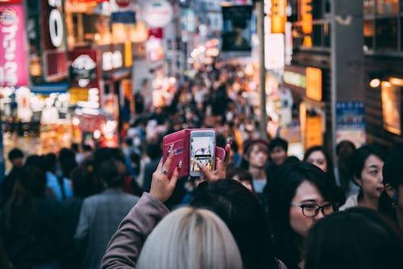
Understanding Travel and
Mass Tourism

Slide 2
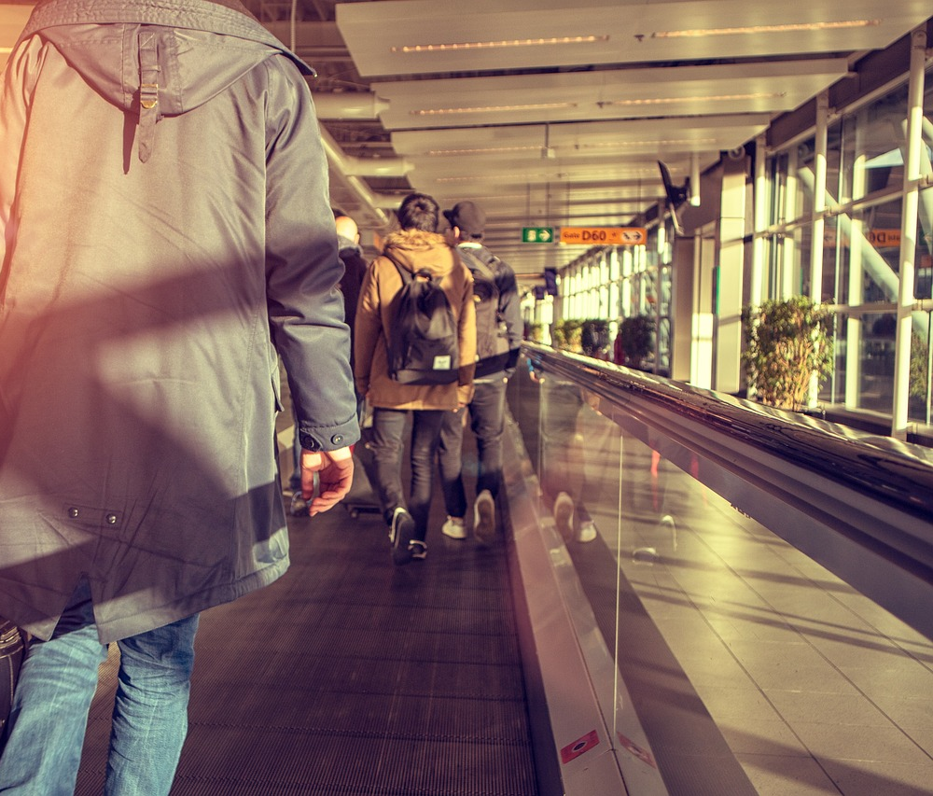
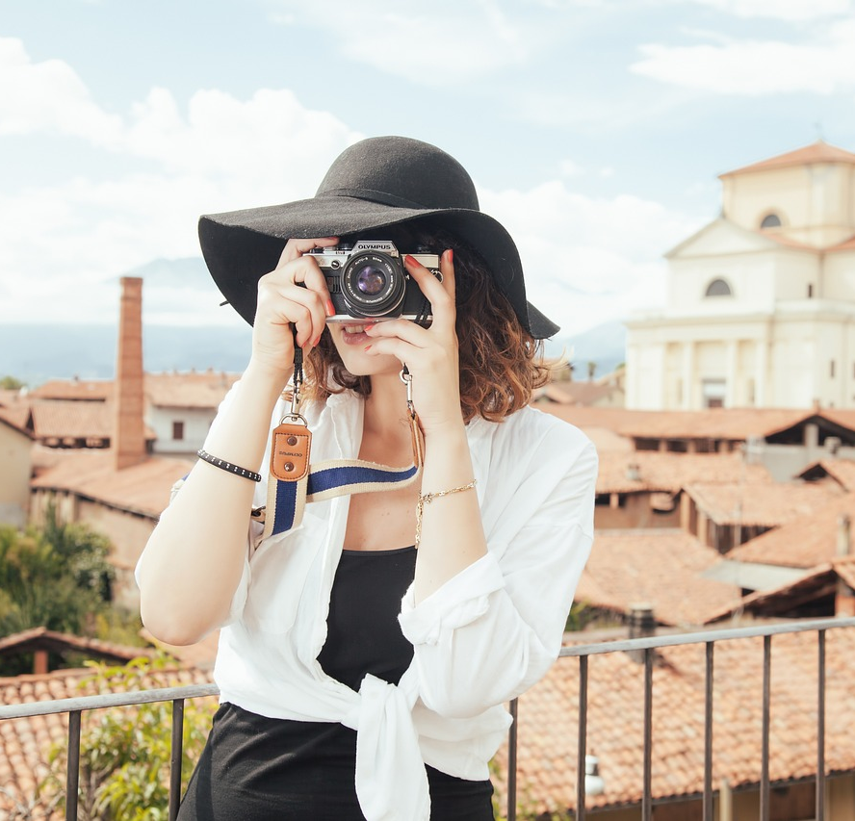
Travel vs. Tourism
Travel → Going from one place to another for any reason.
Example: "I travel to different cities for work.”
Tourism → Traveling for fun or a vacation.
Example: "Paris is a popular place for tourism."

Slide 3
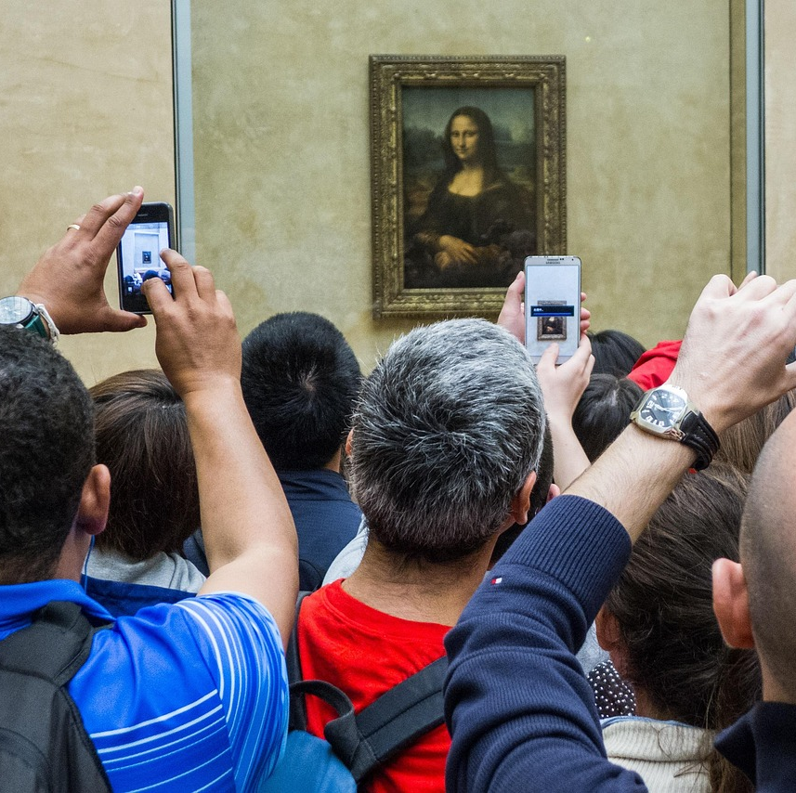
What is mass tourism?
Mass tourism is when a lot of people visit the same place at the same time.
It usually happens in famous places like big cities, beaches, and landmarks.

Slide 4
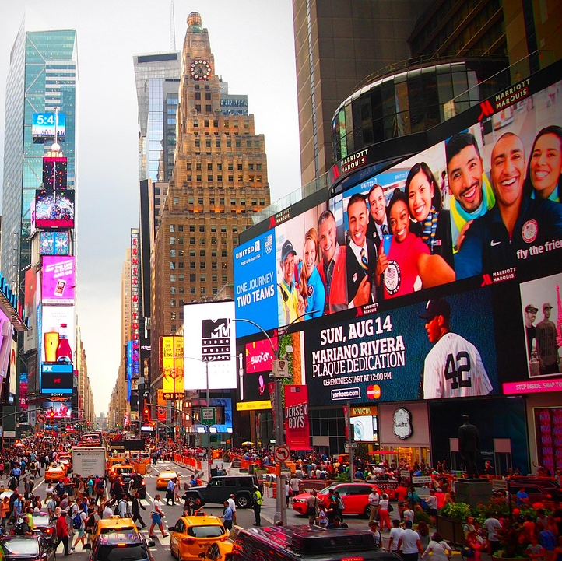
Where do tourists go?
These are some of the most popular destinations for tourism:
Paris – Eiffel Tower 🗼
New York – Times Square 🏙️
Venice – Gondolas & canals 🚤
Thailand – Popular beaches

Slide 5
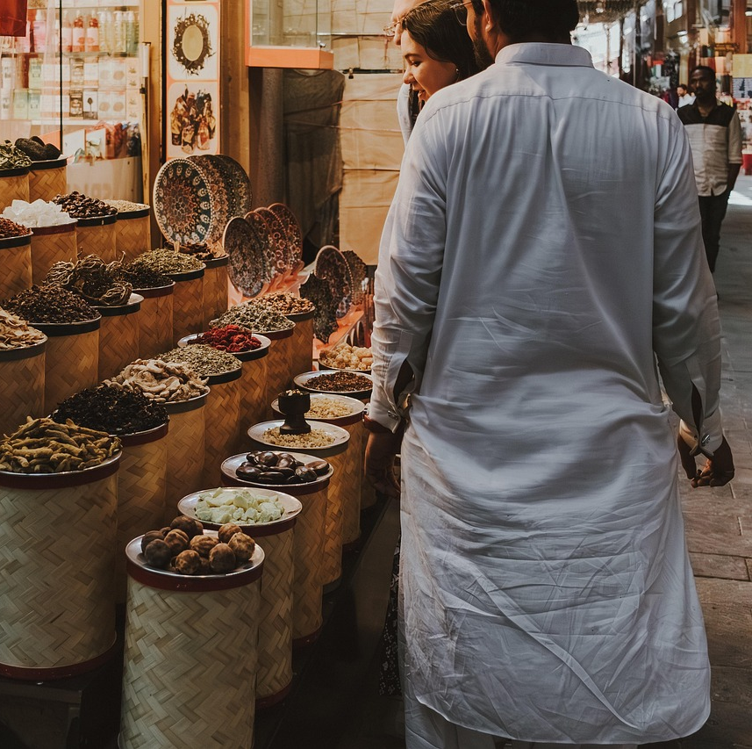
Why is mass tourism good?
✔ More jobs – Hotels, restaurants, and guides make money.
✔ Helps local businesses – Shops sell souvenirs to tourists.
✔ Teaches culture – People learn about new places.

Slide 6
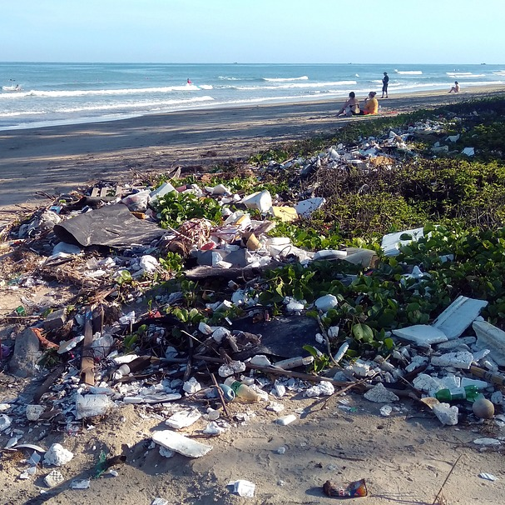
Why is mass tourism a problem?
❌ Too many people – Some places become too crowded.
❌ Pollution – Litter and waste hurt nature.
❌ Damage to history – Old buildings and landmarks can break.

Slide 7
What do you think?
Would you like to visit a famous tourist place? Why or why not?
How can tourists help take care of the places they visit?
Can you think of a place in your country that has a lot of tourists?

